Slide 1
HALCOR Experiments

Slide 2
Tasks
Timeseries forecasting (regression)
Categorical Features : On and Off
Data Granularity (15min, 1h, 4h, 1d, 1w)
Single-step prediction
BiLSTM (Bidirectional LSTM)
XGBoost
Multi-step prediction
BiLSTM
Estimation (Supervised learning regression)
Categorical Features : On and Off
Data Granularity (15min, 1h, 4h, 1d, 1w)
XGBoost

Slide 3
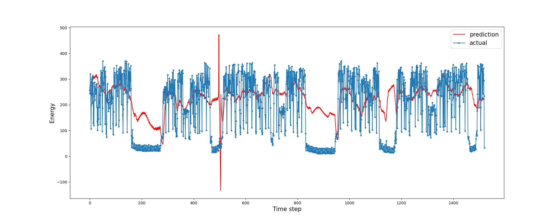
Timeseries forecasting 15 minutes
Parameter | Value
Data Granularity | 15 minutes
Model | BiLSTM
Categorical Features | Off
Prediction Mode | Single-step
Evaluation Metric (R²) | 0.161

Slide 4
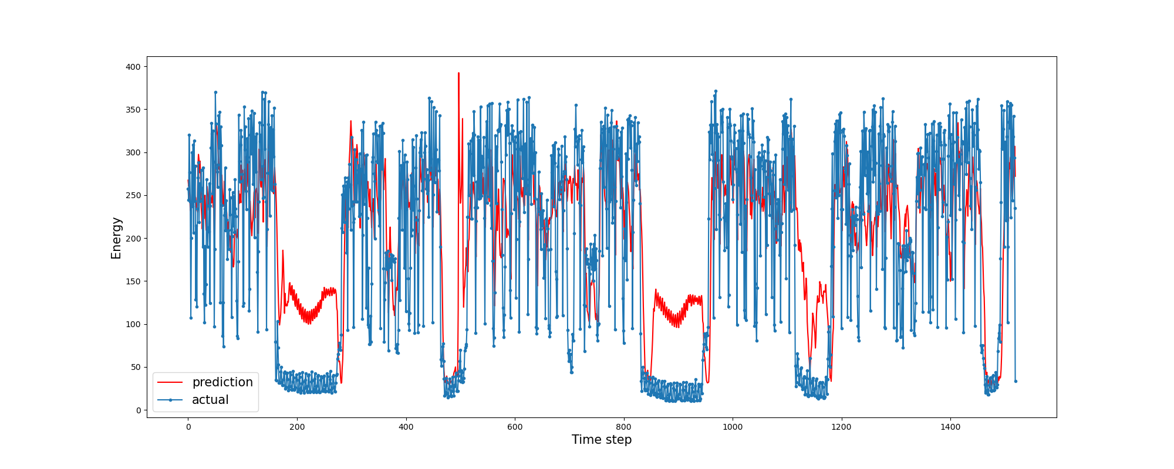
Timeseries forecasting 15 minutes
Parameter | Value
Data Granularity | 15 minutes
Model | BiLSTM
Categorical Features | On
Prediction Mode | Single-step
Evaluation Metric (R²) | 0.51

Slide 5
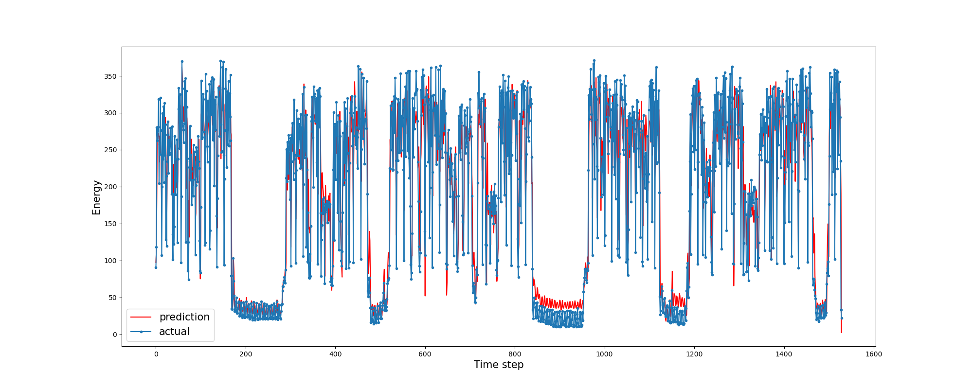
Timeseries forecasting 15 minutes
Parameter | Value
Data Granularity | 15 minutes
Model | XGBoost
Categorical Features | Off
Prediction Mode | Single-step
Evaluation Metric (R²) | 0.868

Slide 6
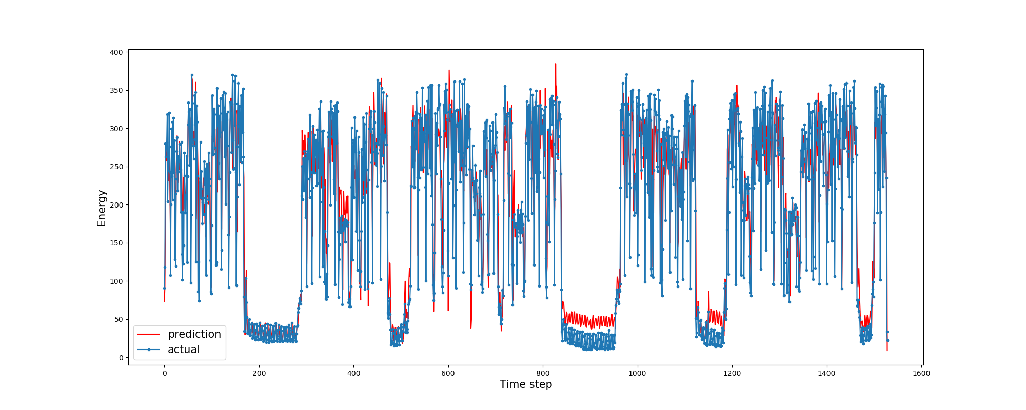
Timeseries forecasting 15 minutes
Parameter | Value
Data Granularity | 15 minutes
Model | XGBoost
Categorical Features | On
Prediction Mode | Single-step
Evaluation Metric (R²) | 0.87

Slide 7
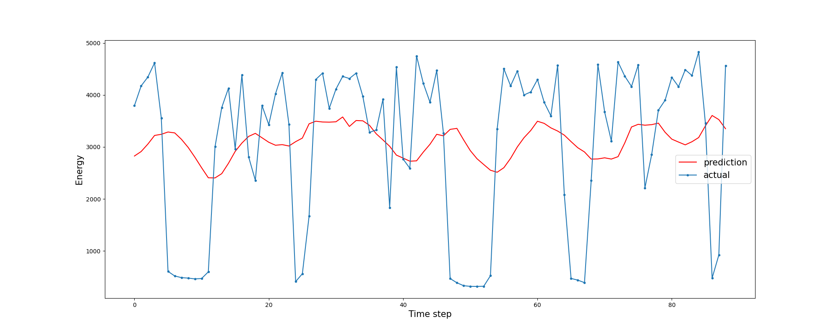
Timeseries forecasting 4 hours
Parameter | Value
Data Granularity | 4h
Model | BiLSTM
Categorical Features | Off
Prediction Mode | Single-step
Evaluation Metric (R²) | 0.014

Slide 8
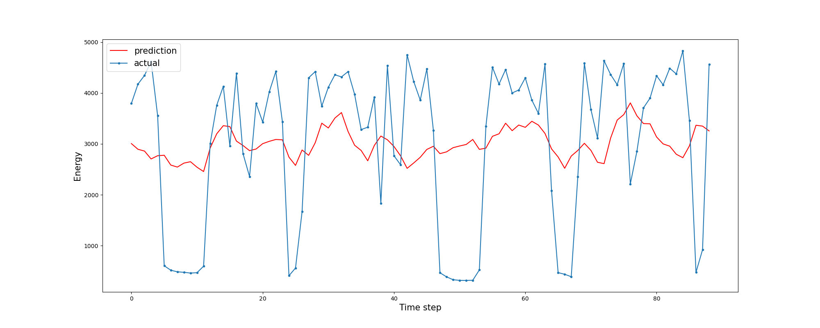
Timeseries forecasting 4 hours
Parameter | Value
Data Granularity | 4h
Model | BiLSTM
Categorical Features | On
Prediction Mode | Single-step
Evaluation Metric (R²) | 0.1

Slide 9
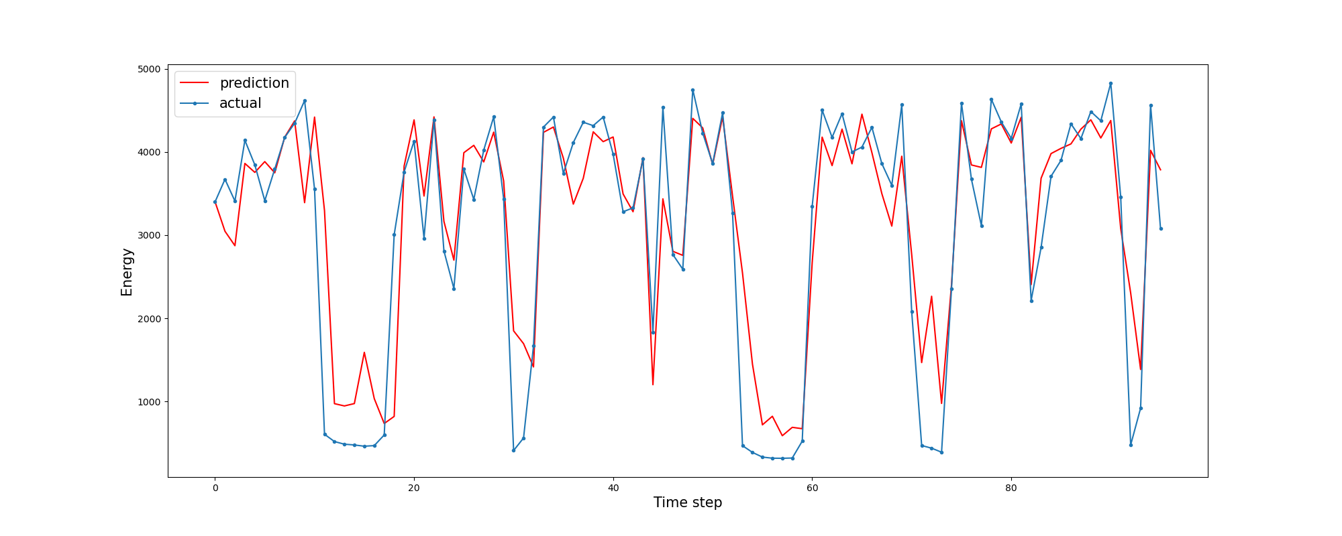
Timeseries forecasting 4 hours
Parameter | Value
Data Granularity | 4h
Model | XGBoost
Categorical Features | Off
Prediction Mode | Single-step
Evaluation Metric (R²) | 0.797

Slide 10
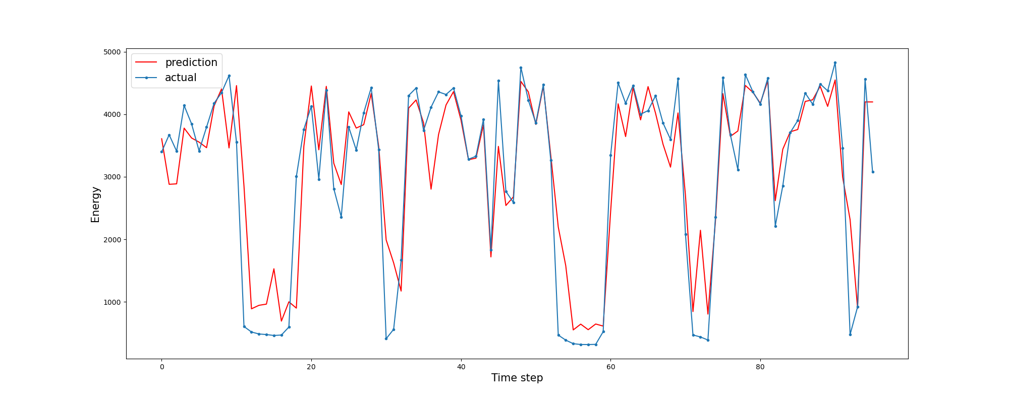
Timeseries forecasting 4 hours
Parameter | Value
Data Granularity | 4h
Model | XGBoost
Categorical Features | On
Prediction Mode | Single-step
Evaluation Metric (R²) | 0.818

Slide 11
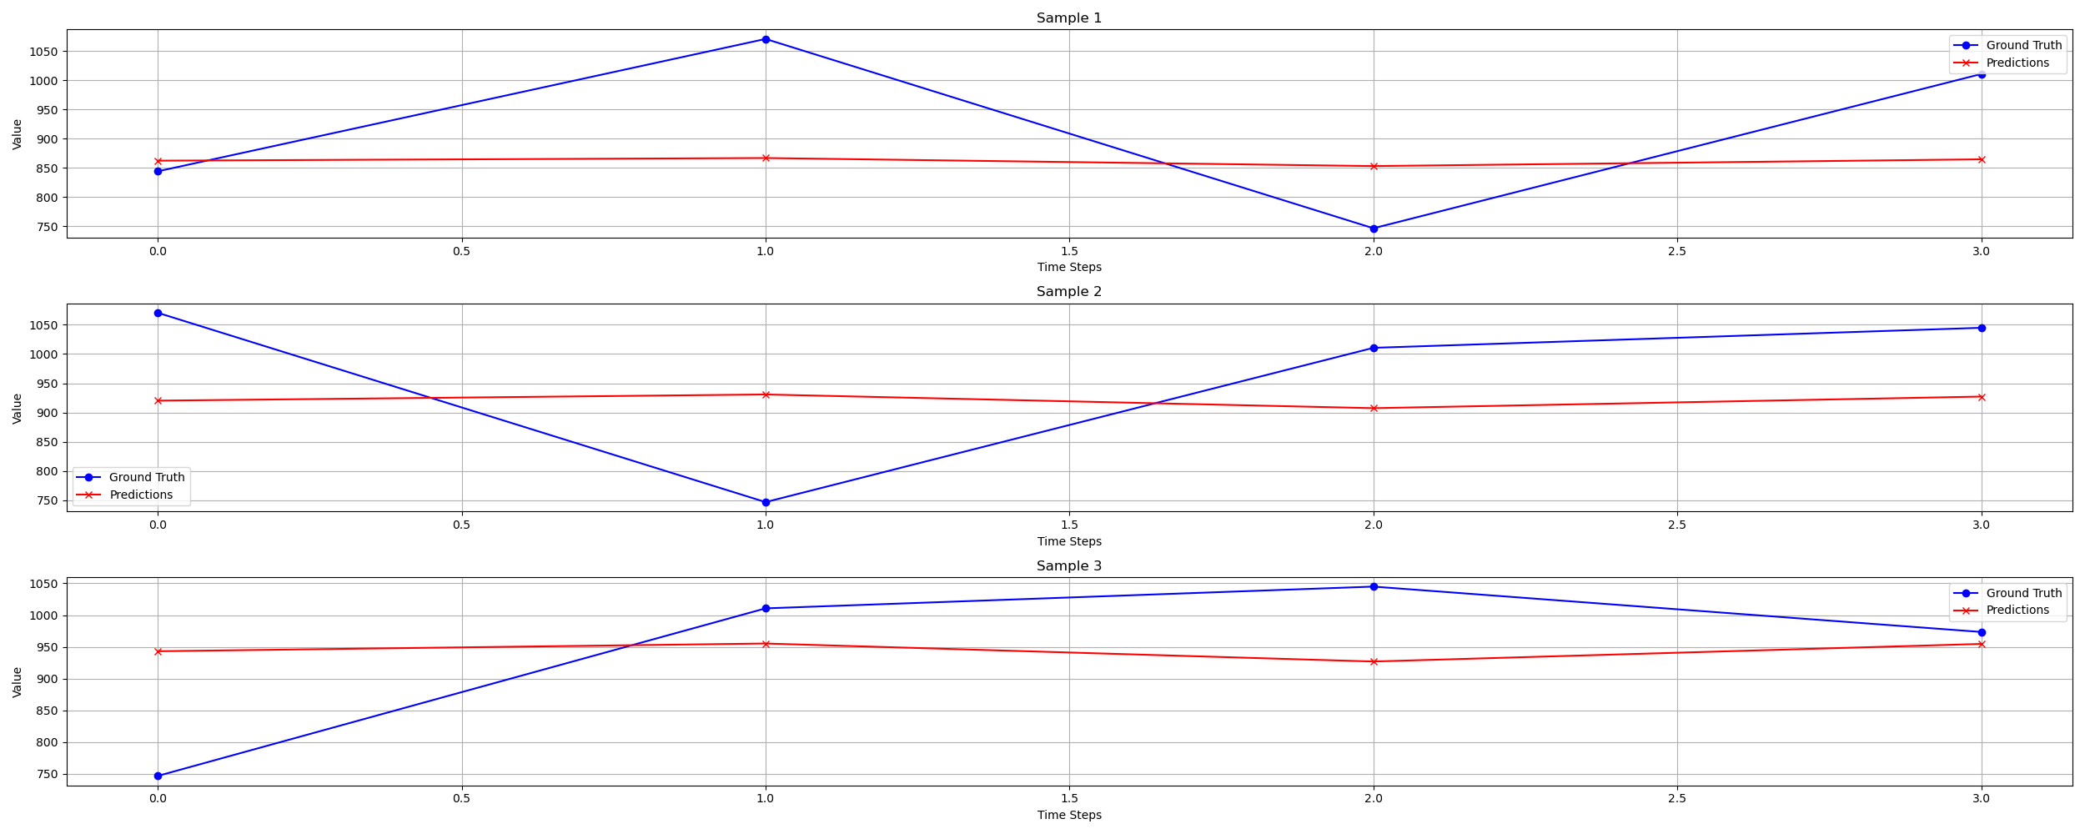
Timeseries forecasting 4 hours
Parameter | Value
Data Granularity | 1h
Model | BiLSTM
Categorical Features | Off
Prediction Mode | Multi-step
Evaluation Metric (R²) | -0.27

Slide 12
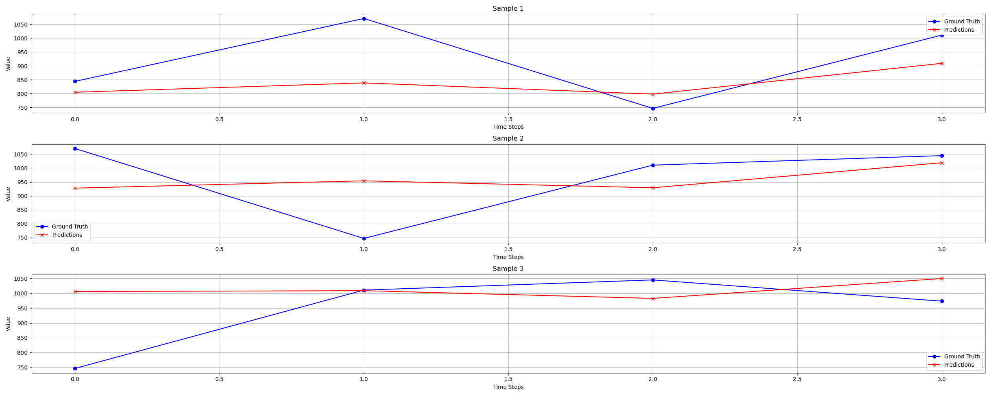
Timeseries forecasting 4 hours
Parameter | Value
Data Granularity | 1h
Model | BiLSTM
Categorical Features | On
Prediction Mode | Multi-step
Evaluation Metric (R²) | 0.149

Slide 13
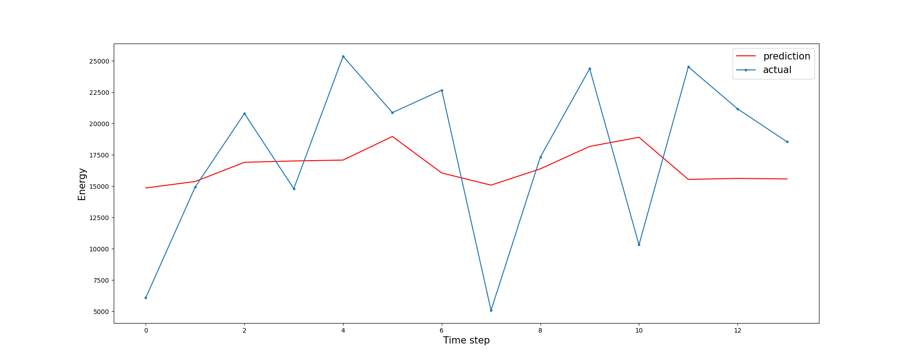
Timeseries forecasting 1 day
Parameter | Value
Data Granularity | 1d
Model | BiLSTM
Categorical Features | Off
Prediction Mode | Single-step
Evaluation Metric (R²) | 0.044

Slide 14
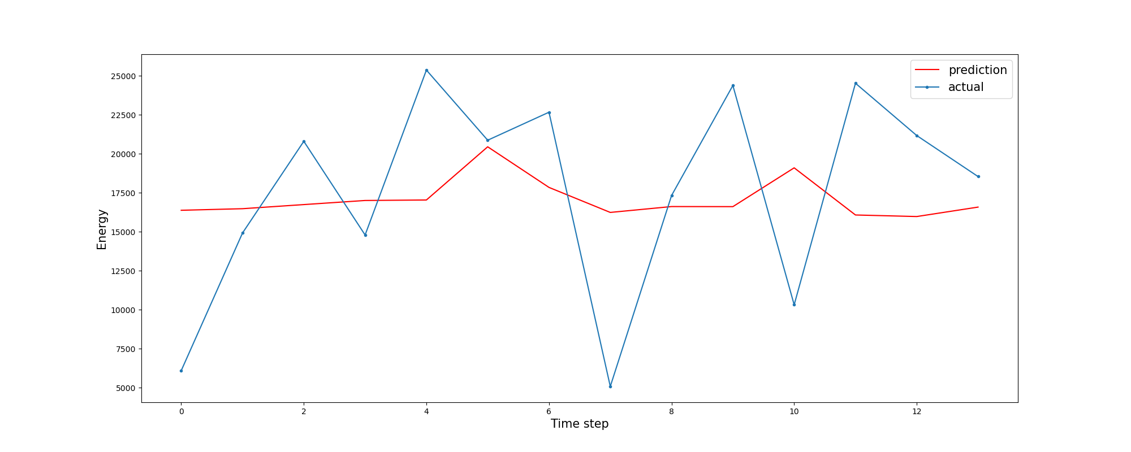
Timeseries forecasting 1 day
Parameter | Value
Data Granularity | 1d
Model | BiLSTM
Categorical Features | On
Prediction Mode | Single-step
Evaluation Metric (R²) | -0.02

Slide 15
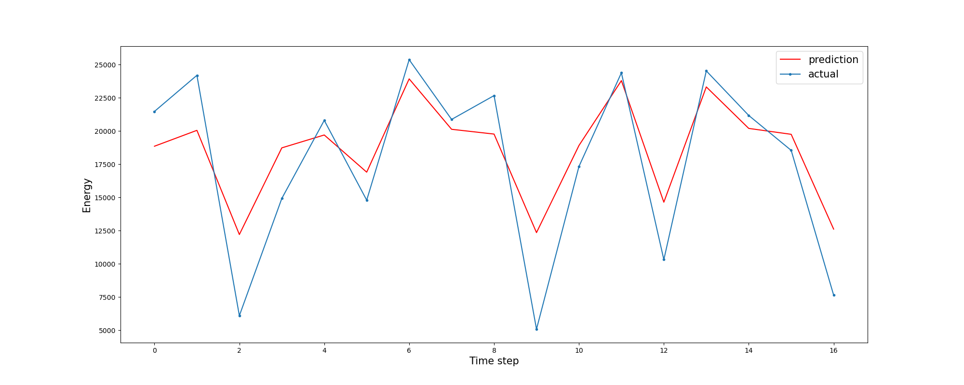
Timeseries forecasting 1 day
Parameter | Value
Data Granularity | 1d
Model | XGBoost
Categorical Features | Off
Prediction Mode | Single-step
Evaluation Metric (R²) | 0.73

Slide 16

Timeseries forecasting 1 day
Parameter | Value
Data Granularity | 1d
Model | XGBoost
Categorical Features | On
Prediction Mode | Single-step
Evaluation Metric (R²) | 0.77

Slide 17
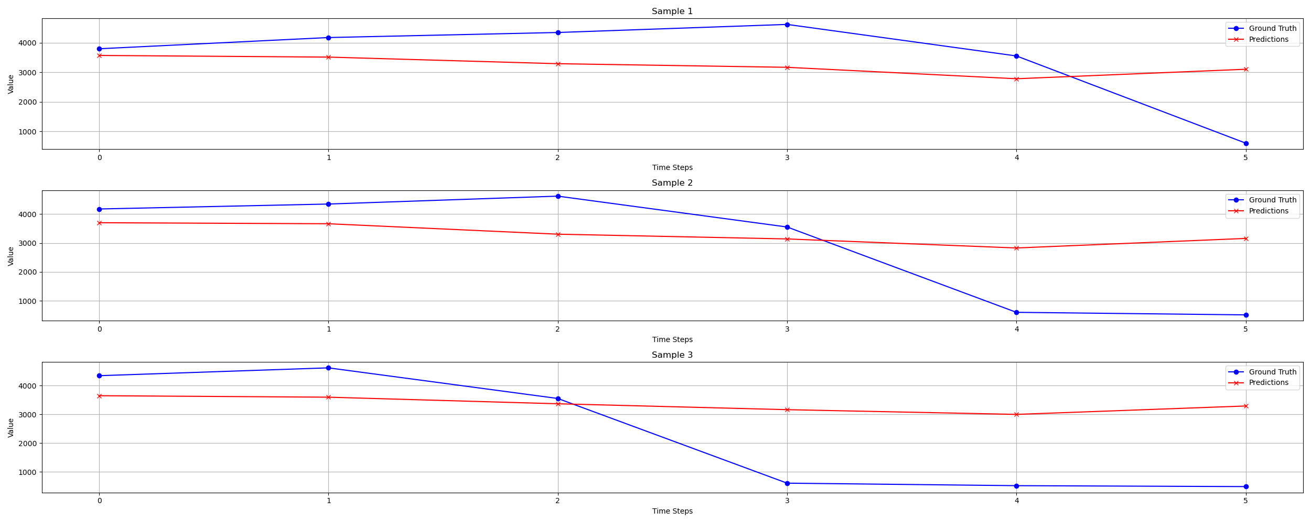
Timeseries forecasting 1 day
Parameter | Value
Data Granularity | 4h
Model | BiLSTM
Categorical Features | Off
Prediction Mode | Multi-step
Evaluation Metric (R²) | 0.02

Slide 18
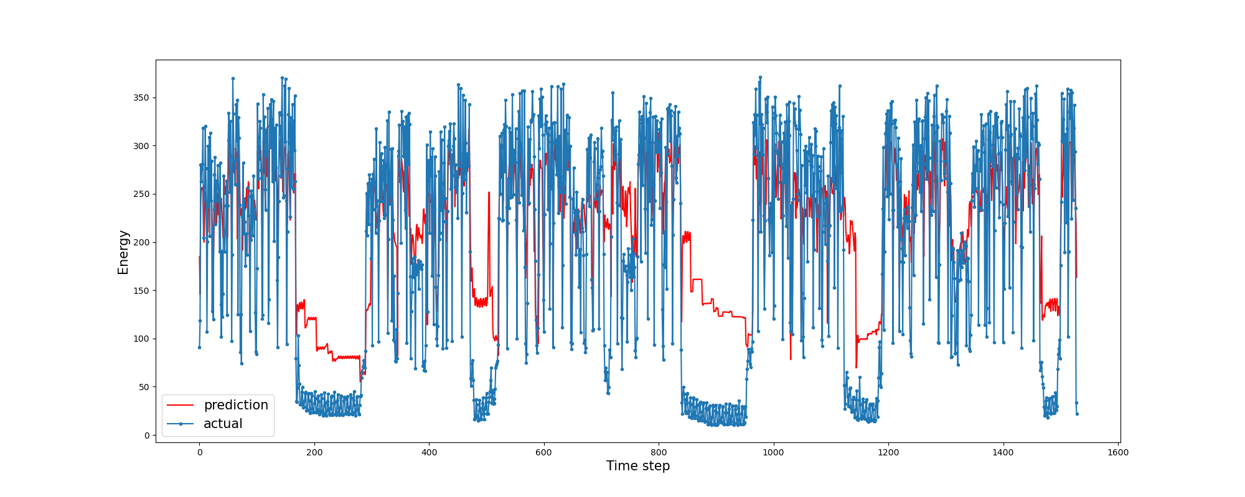
Estimation 15 minutes
Parameter | Value
Data Granularity | 15 minutes
Model | XGBoost
Categorical Features | Off
Evaluation Metric (R²) | 0.61

Slide 19
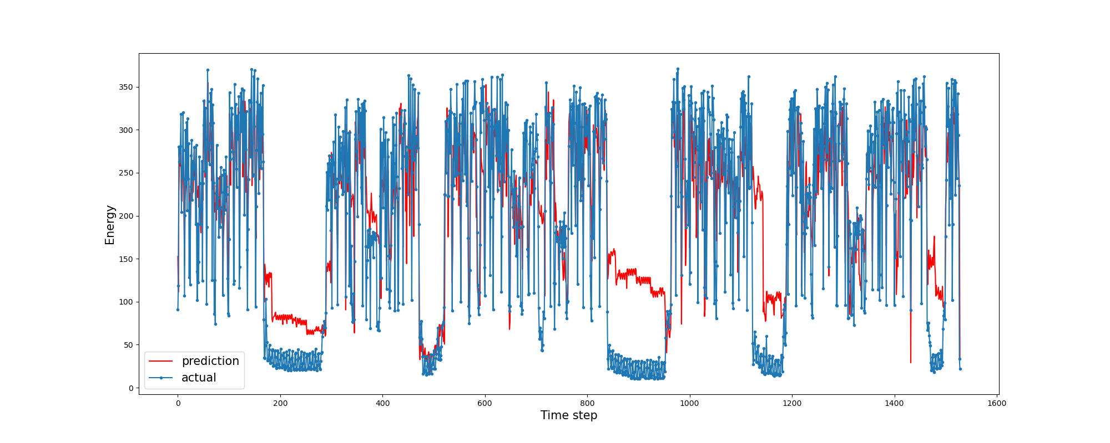
Estimation 15 minutes
Parameter | Value
Data Granularity | 15 minutes
Model | XGBoost
Categorical Features | On
Evaluation Metric (R²) | 0.7

Slide 20
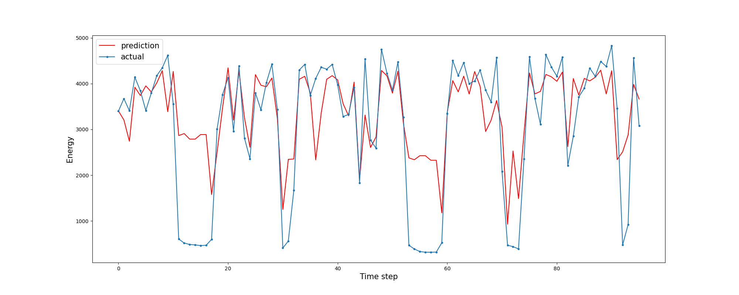
Estimation 4 hours
Parameter | Value
Data Granularity | 4h
Model | XGBoost
Categorical Features | Off
Evaluation Metric (R²) | 0.55

Slide 21
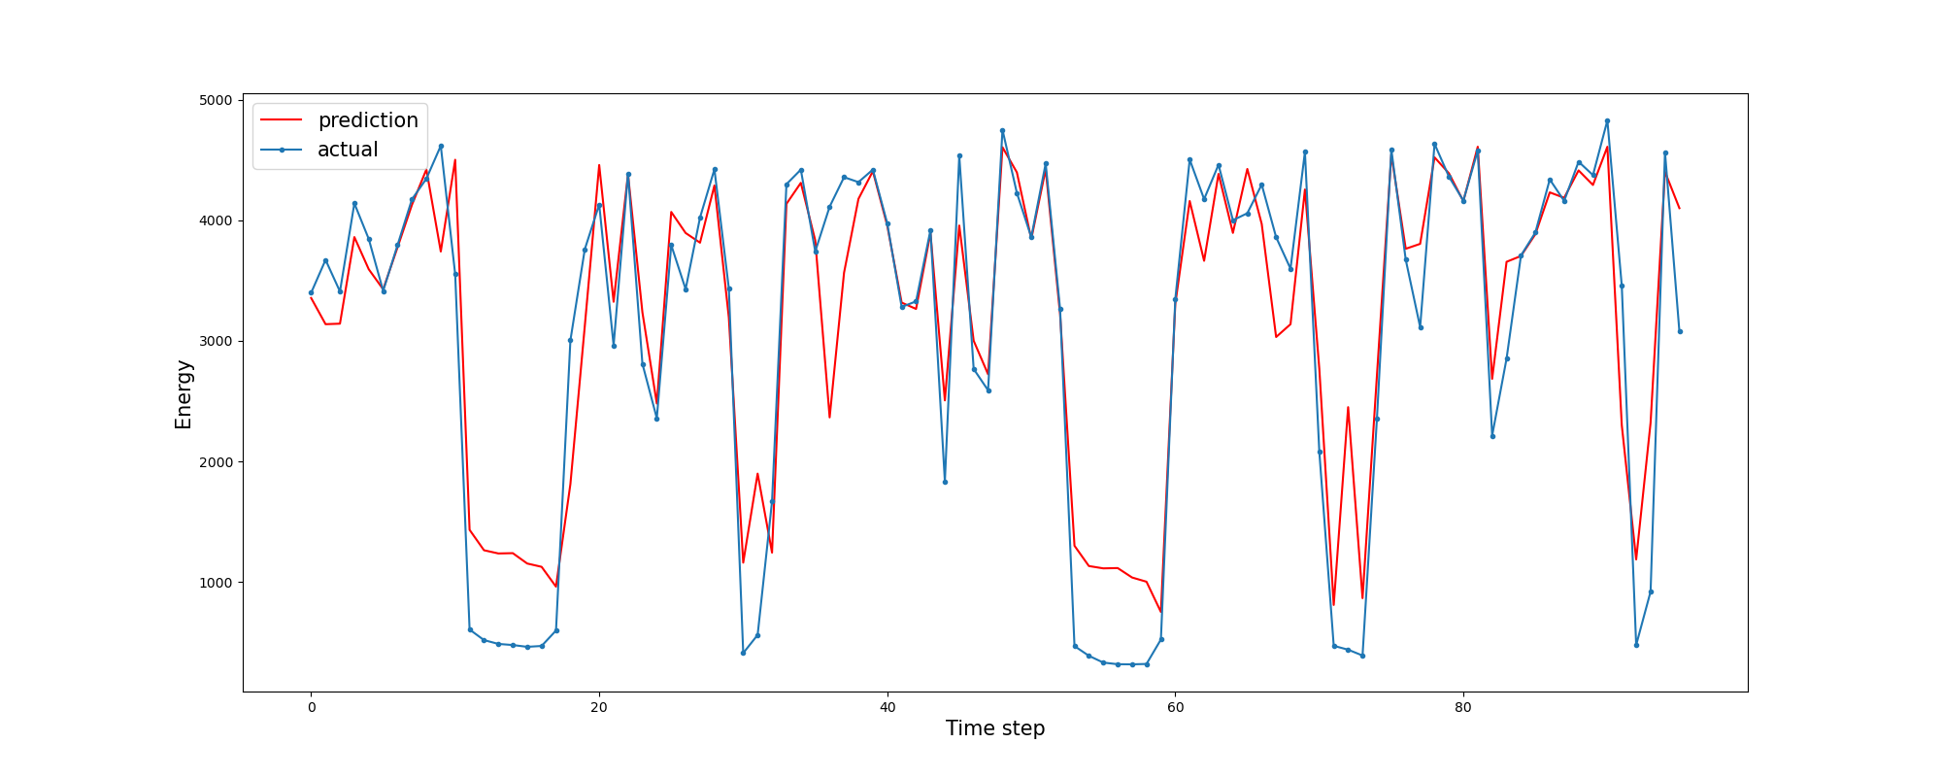
Estimation 4 hours
Parameter | Value
Data Granularity | 4h
Model | XGBoost
Categorical Features | On
Evaluation Metric (R²) | 0.85

Slide 22
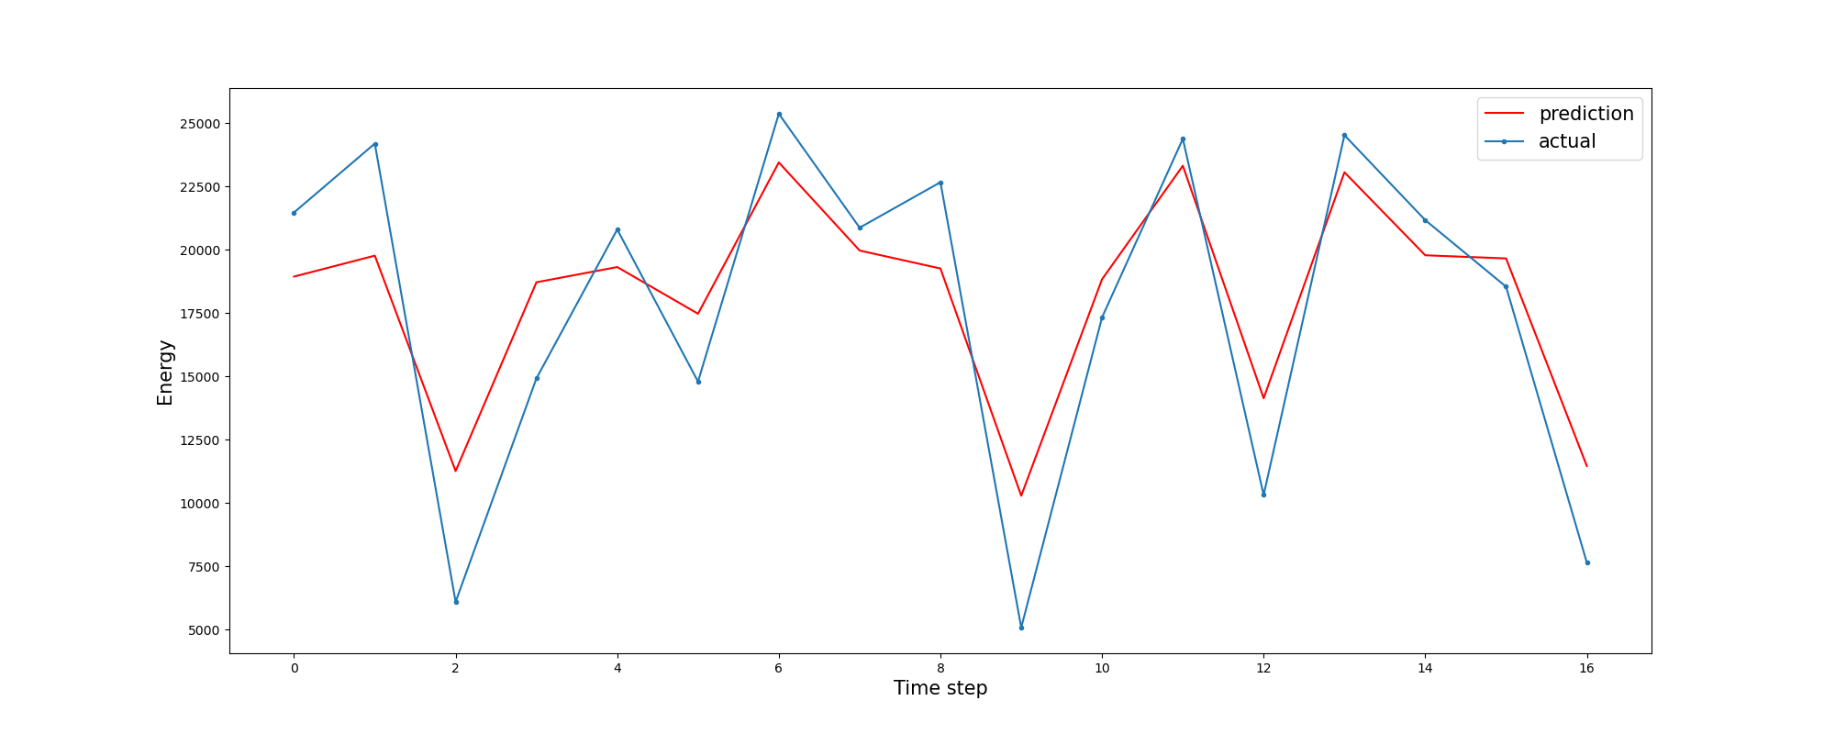
Estimation 1 day
Parameter | Value
Data Granularity | 1d
Model | XGBoost
Categorical Features | Off
Evaluation Metric (R²) | 0.784

Slide 23
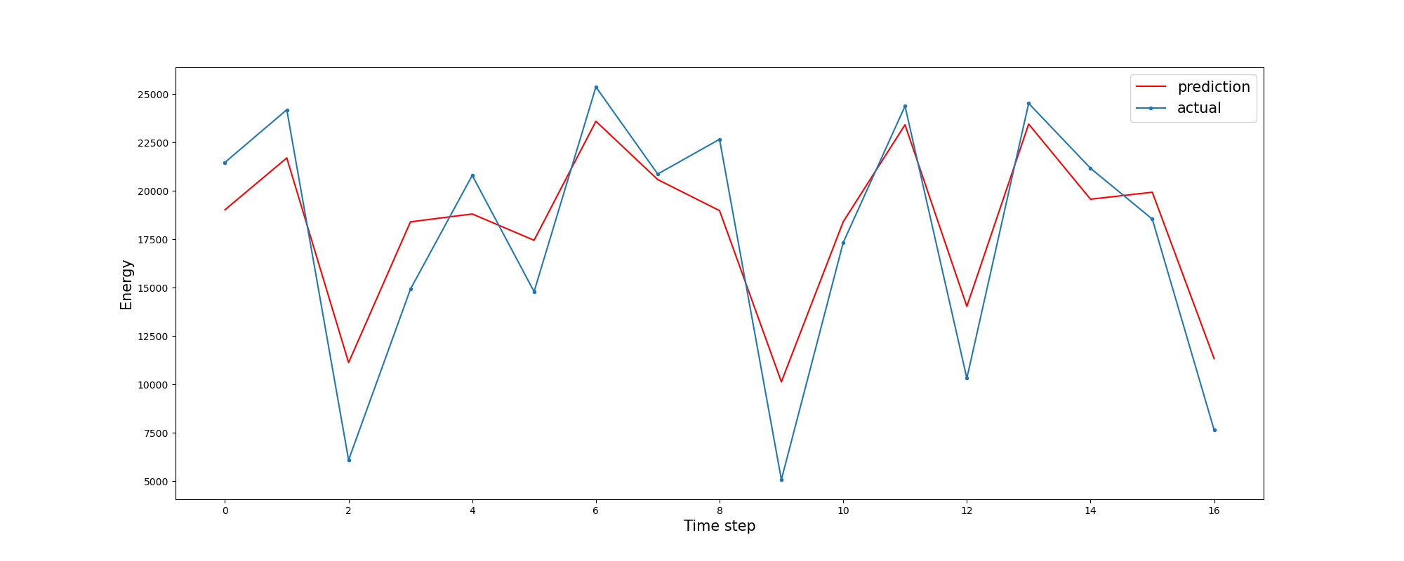
Estimation 1 day
Parameter | Value
Data Granularity | 1d
Model | XGBoost
Categorical Features | On
Evaluation Metric (R²) | 0.81

Slide 24
Summary of best results
Summary | Timeseries | Estimation
15min | categorical:on_XGBoost_single-step -> 0.87 | categorical:on_XGBoost -> 0.7
4h | categorical:on_XGBoost_single-step -> 0.818 | categorical:on_XGBoost -> 0.85
1d | categorical:on_XGBoost_single-step -> 0.77 | categorical:on_XGBoost -> 0.81
1w | Insufficient Data | Insufficient Data

